Slide 1
Modernizing PowerShell Scripts

Slide 2

whoami
Matthias van den Elsacker
Axxes IT Consultancy since 2014
System Engineer @ Umicore since 2014
First Line Support for 1 year
Second/Third Line SCCM for 4 years
Network Engineer @ Umicore since 2019
Contact: Matthias.vandenElsacker@axxes.com
(No Twitter or LinkedIn, sorry)

Slide 3
Introduction
Why this session

Slide 4
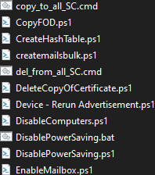
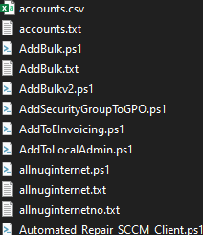
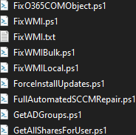
My Collection of Scripts

Slide 5
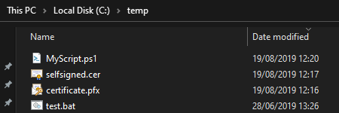

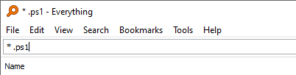
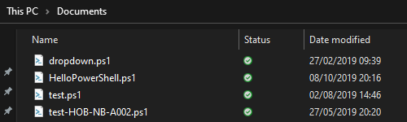
Where did I leave these again?

Slide 6


Problem? Solution!

Slide 7
Talking points
Best practices
PowerShell to PowerShell Core
ISE to Visual Studio Code
Git
(If there’s some time left.)

Slide 8
Best Practices
And style rules

Slide 9
lowercase, PascalCase, UPPERCASE
lowercase: Powershell Keywords
foreach, switch, return, -eq, -like,…
PascalCase: All public identifiers
Functions, Modules, Cmdlets, Attributes, Classes,…
Do-Something, $SomeVariable, MyModule.psm1,…
UPPERCASE: Comment-based help keywords
.SYNOPSIS, .EXAMPLE, .DESCRIPTION,…

Slide 10
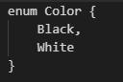
“One True Brace Style”
Brackets open at the end of a line.
Brackets close at the beginning of a line.
Exception: short CommandBlocks.

Slide 11
Verb-Noun
All PowerShell Modules, Functions and Cmdlets follow this rule.
Get-Process, New-LocalUser, Clear-Content,…
Follow this rule when creating functions.
Repair-Wmi, Add-DomainUserToLocalAdmins, Get-RootCertificatesFromComputer
List of approved Verbs:
Get-Verb

Slide 12
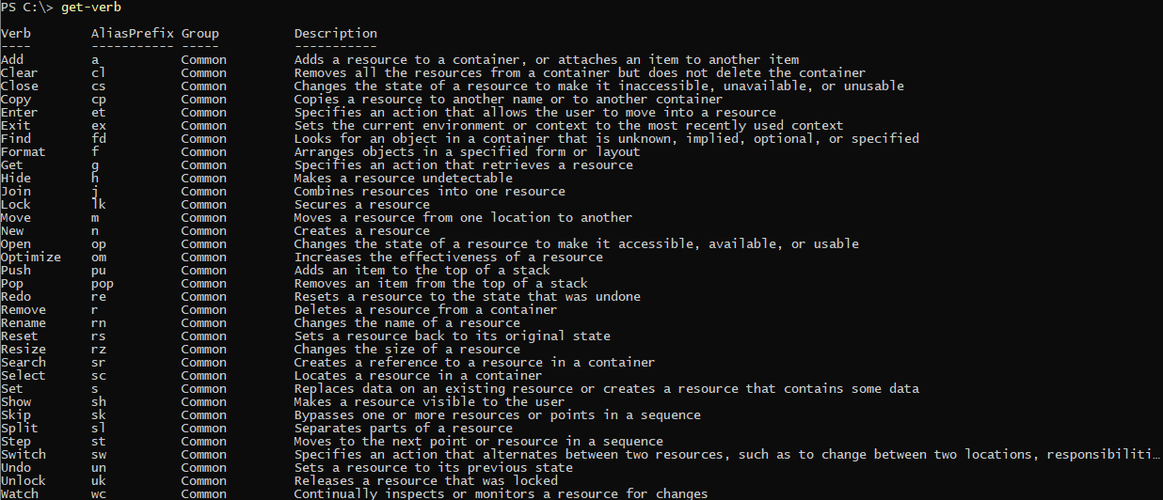

Slide 13
Aliases
Aliases are cool and all, but…
… make code hard to understand.
So try to avoid them.
(Unless you are playing Code Golf)

Slide 14
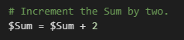
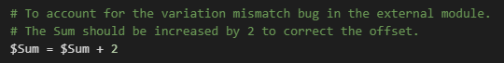
Comments
Comments should be useful.
Not useful:
Useful:

Slide 15
Other Best Practices

Slide 16
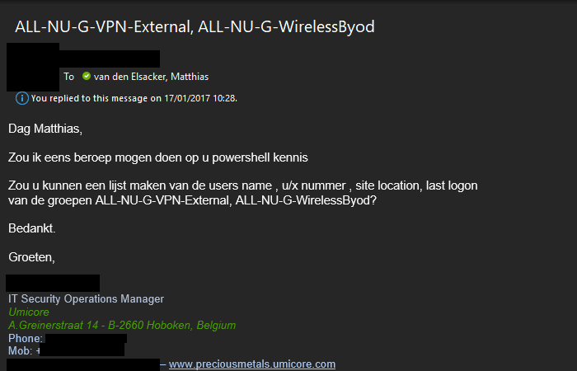

Slide 17


Slide 18
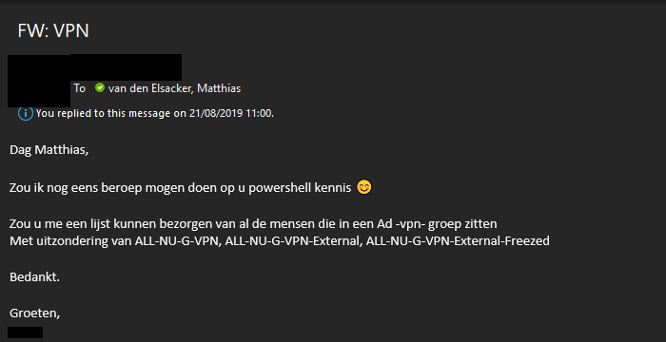

Slide 19


Slide 20
Other Best Practices
Re-usability

Slide 21
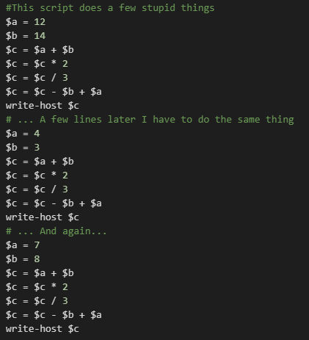

Slide 22
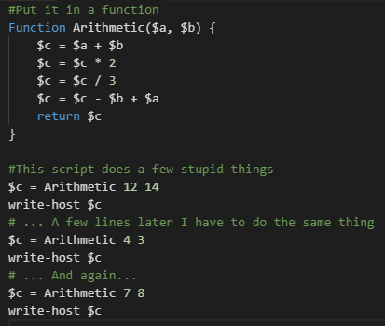

Slide 23
Other Best Practices
Re-usability
Modularity

Slide 24
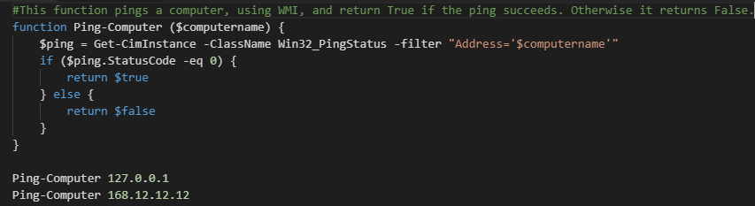

Slide 26
Other Best Practices
Re-usability
Modularity
Don’t re-invent the wheel

Slide 27
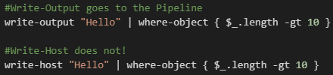
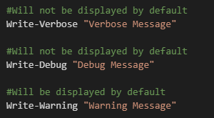
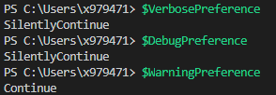
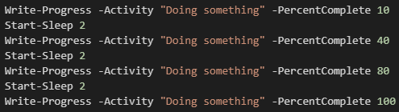

Slide 28
Other Best Practices
Re-usability
Modularity
Don’t re-invent the wheel
Write-*

Slide 29
PowerShell to PS Core
Moving to an open-source, cross-platform version

Slide 30
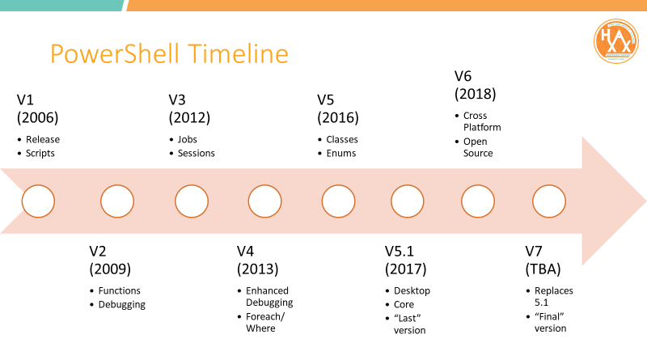

Slide 31
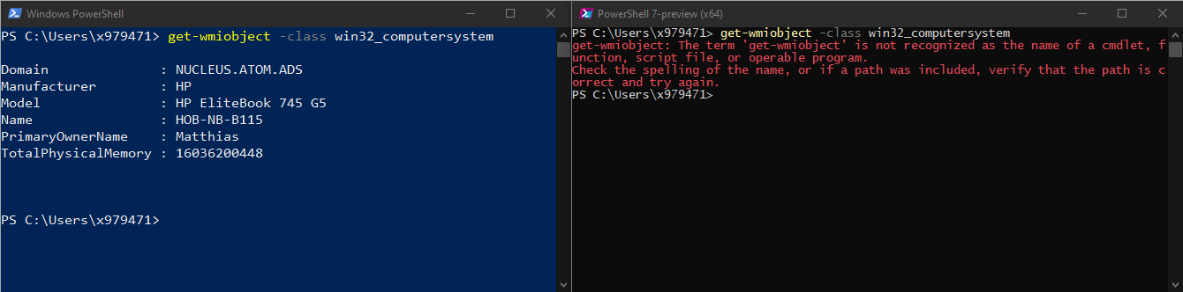
What’s broken?

Slide 32
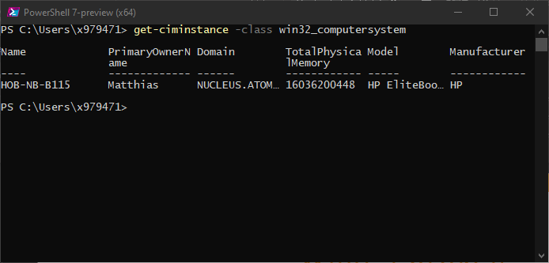
Solution!

Slide 33
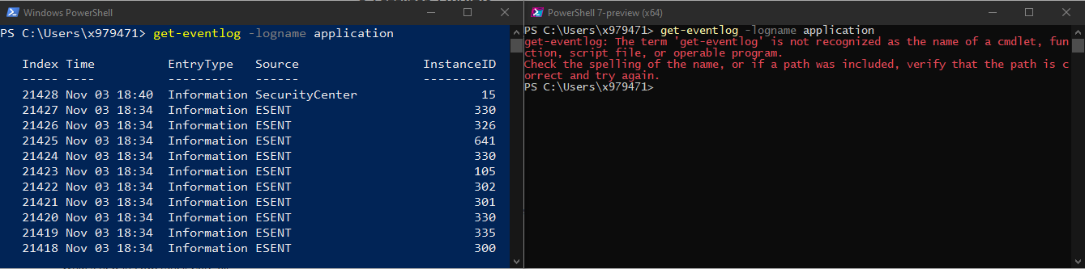
What’s broken?

Slide 34
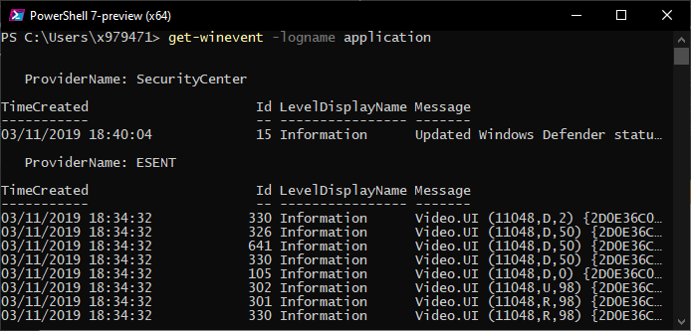
Solution!

Slide 35
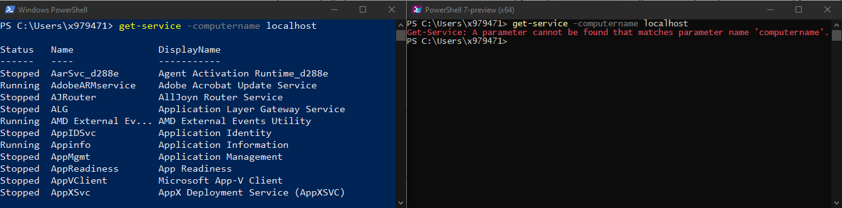
What’s broken?

Slide 36
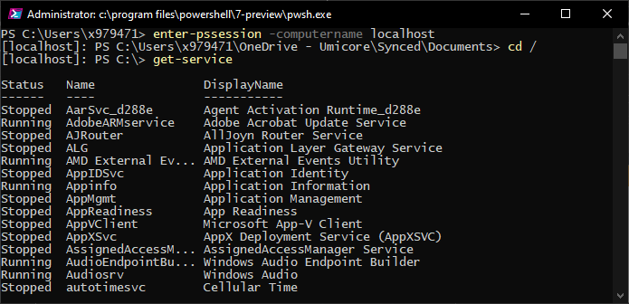
Solution!

Slide 37
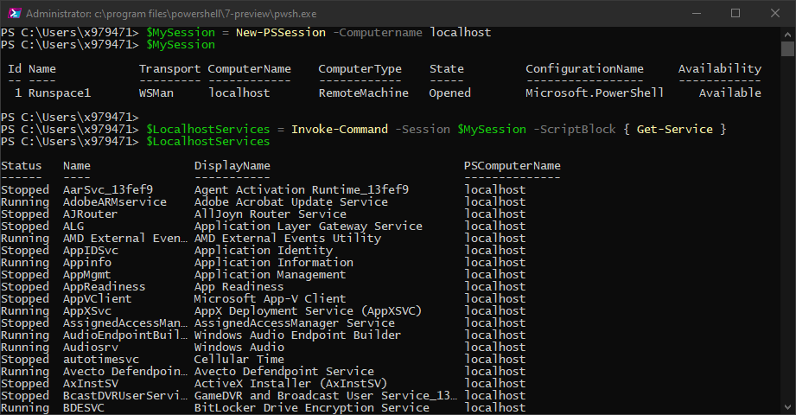
Solution!

Slide 38
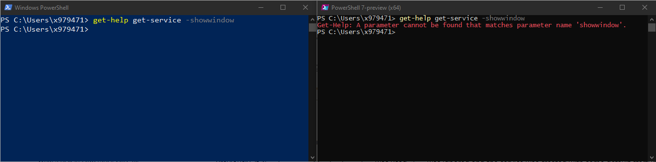
What’s broken?

Slide 39

Solution?
❌

Slide 40
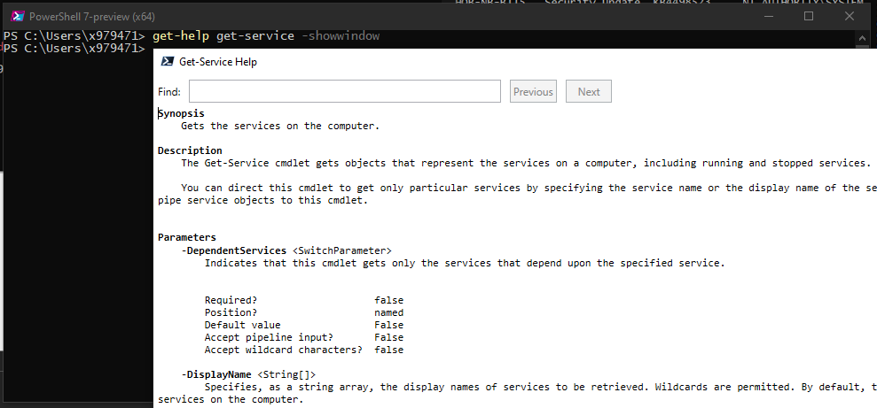
PowerShell Core keeps evolving…

Slide 41
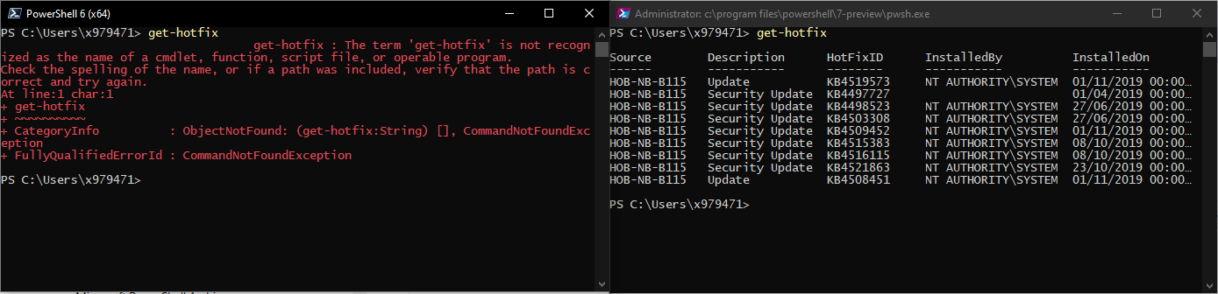
PowerShell Core keeps evolving…

Slide 42
What about Linux?
Cross-Platform PowerShell

Slide 43
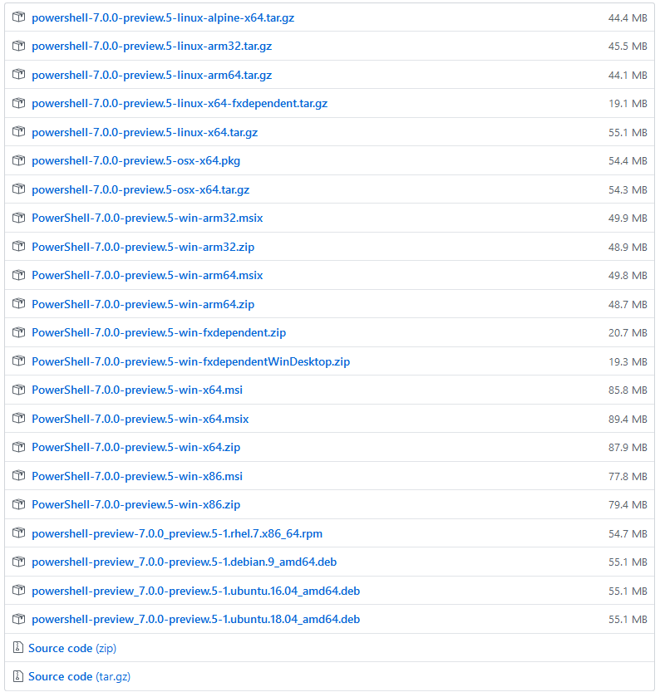
PowerShell comes in a lot of flavors

Slide 44
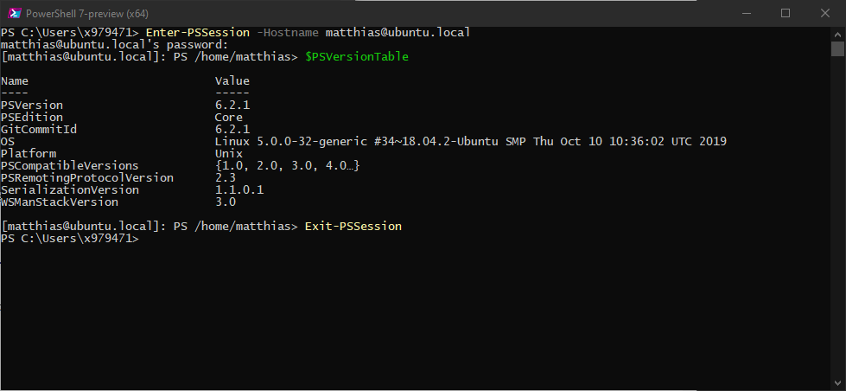
Remote Connection to Linux

Slide 45
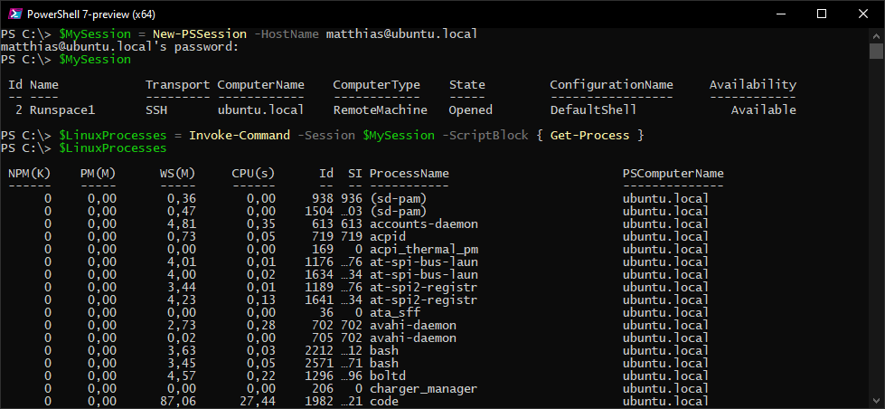
Remote Connection to Linux

Slide 46
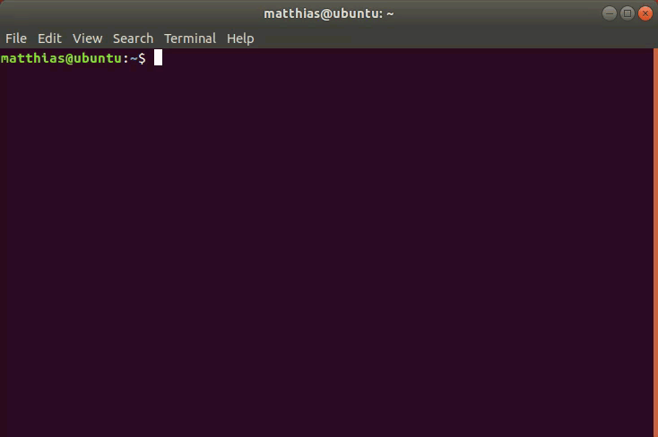
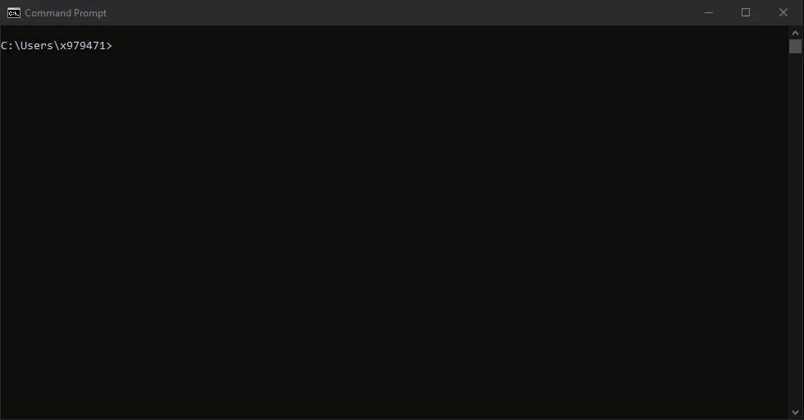
Windows vs Linux

Slide 47
ISE vs Code
Out with the old, in with the new

Slide 48


In Memoriam

Slide 49

Welcome Visual Studio Code

Slide 50

Main advantages
Workspaces, folders, and files
Add-ons
Themes
Cross Platform
Debugging
Multiple terminals
Integrated GIT
Not just for PowerShell
It’s just better and cooler

Slide 51
Git
And GitHub for System Engineers

Slide 52


“A solution for growing pains”

Slide 53
G-I-T
Random three-letter combination that is pronounceable, and not actually used by any common UNIX command. The fact that it is a mispronunciation of "get" may or may not be relevant.
Stupid. Contemptible and Despicable. Simple. Take your pick from the dictionary of slang.
“Global information tracker": you're in a good mood, and it actually works for you. Angels sing, and a light suddenly fills the room.
“Goddamn idiotic truckload of sh*t": when it breaks

Slide 54


Slide 55
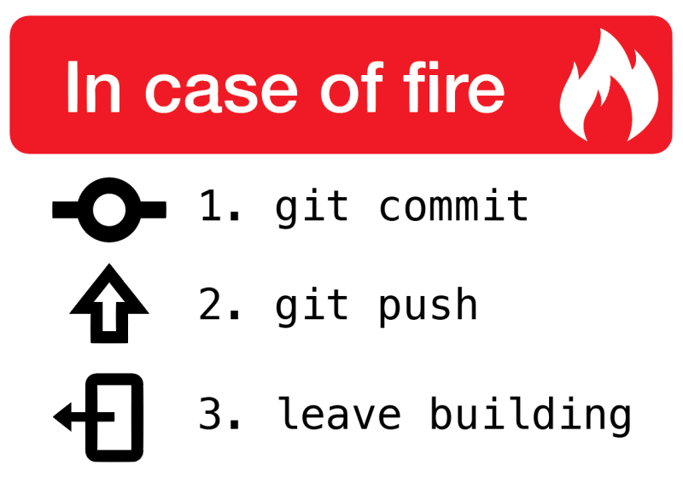

Slide 56
Pester
Testing PowerShell, using PowerShell

Slide 57
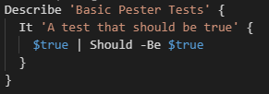
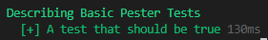
Pester
Test Framework
For PowerShell
Written in PowerShell
DSL Syntax:
“Describe”
“It”
“Should”

Slide 58
Type of Tests
Unit Testing
In isolation (using $TestDrive)
No external code (using Mocks)
Integration Testing
“White/Clear Box Testing”
Integration with external code
Acceptance Testing
“Black Box Testing”
Third party

Slide 59
Thank you!

Slide 60
Resources
https://github.com/PoshCode/PowerShellPracticeAndStyle
https://poshcode.gitbooks.io/powershell-practice-and-style/
https://docs.microsoft.com/en-us/powershell/scripting/whats-new/breaking-changes-ps6?view=powershell-6
https://4sysops.com/archives/make-visual-studio-code-look-and-behave-like-powershell-ise/
https://docs.microsoft.com/en-us/powershell/scripting/learn/remoting/ssh-remoting-in-powershell-core?view=powershell-6
https://github.com/PowerShell/psl-omi-provider
https://lkml.org/lkml/1998/9/30/122
https://guides.github.com/activities/hello-world/
https://github.com/pester/Pester
https://www.red-gate.com/simple-talk/sysadmin/powershell/introduction-to-testing-your-powershell-code-with-pester/

